Slide 1
Capstone project 2: Toxic Comment Classification Challenge
Grace Liu

Slide 2
Project Overview
Project Objective: Predicting the probability of each type of toxicity for each comment.
Data description: With one explanatory variable which is the text comments, and 6 independent variables describing the types of the toxic comments.
Other research questions:
1) Correlation between the types of comments.
2) How do the comments distribute in terms of the types of the comments?
3) How many comments have multiple labels?
Audience of the analysis: Policy makers, regulators, parents and school officers

Slide 3
Data Wrangling
Step1: Understanding the data, column types, data frame shape, correlation between variables.
Step2: Removing outliers
Step3: Imputing missing values
Step4: Data preprocessing

Slide 4
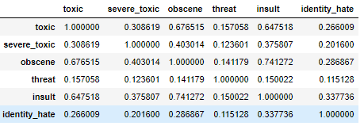
Correlation between the types of comments
The figure shows that comments being toxic is highly correlated with comments being obscene. (0.67) Also, comments being insult is highly correlated with comments being obscene (0.74).

Slide 5
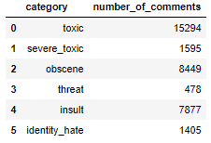
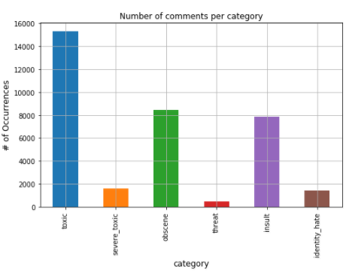
Number of comments by comments type
Comments that are labeled as bad are about one tenth of the total comments. Out of all the types of comments, 15294 comments are labeled as toxic, 8449 are labeled as obscene, and 7877 are labeled as insult.

Slide 6
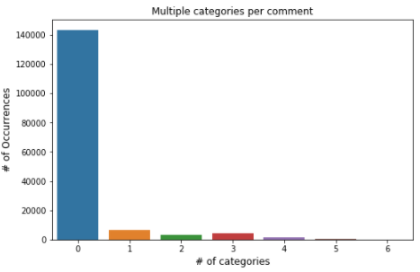
How many comments have multiple labels?
89.8% of the comments have no labels. For the rest 10.2% of the comments, most of them have only one label.

Slide 7
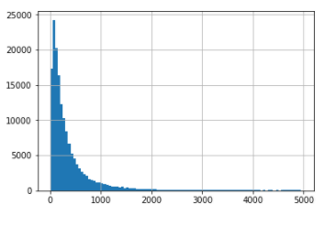
The distribution of the number of words in comment texts

Slide 8
Machine Learning Models
Machine learning models used are:
Logistic Regression, Naïve Bayes, Linear SVC
Models are evaluated using accuracy score, models are ranked by accuracy below with the best parameter in the bracket:
1. Linear SVC (c=0.1)
2. Logistic Regression (c=10)
3. Naïve Bayes

Slide 9
Stacking models for prediction
Hyper-parameter tuning was done for the better perform models.
The stacked model used the majority voting of the three models.
The accuracy score for the stack model is better than the accuracy score for the different models respectively.
Prediction was made using the stack model, and the result was submitted to Kaggle.

